Slide 1
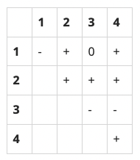
1248 – GUESS (https://www.acmicpc.net/problem/1248)
문제
Given a sequence of integers, a₁, a₂, …, a_{n}, we define its sign matrix S such that, for 1 ≤ i ≤ j ≤ n, S_{ij}="+" if a_{i} + … + a_{j} > 0; S_{ij}="−" if a_{i} + … + a_{j} < 0; and S_{ij}="0" otherwise.
Write a program that, given a valid sign matrix, can find a sequence of integers that generates the sign matrix. You may assume that every integer in a sequence is between −10 and 10, both inclusive.
입력
The first line contains an integer n(1 ≤ n ≤ 10), where n is the length of a sequence of integers. The second line contains a string of n(n+1)/2 characters such that the first n characters correspond to the first row of the sign matrix, the next n−1 characters to the second row, ..., and the last character to the n-th row.
출력
Output exactly one line containing a sequence of n integers which generates the sign matrix. If more than one sequence generates the sign matrix, you may output any one of them. Every integer in the sequence must be between −10 and 10, both inclusive.

Slide 2
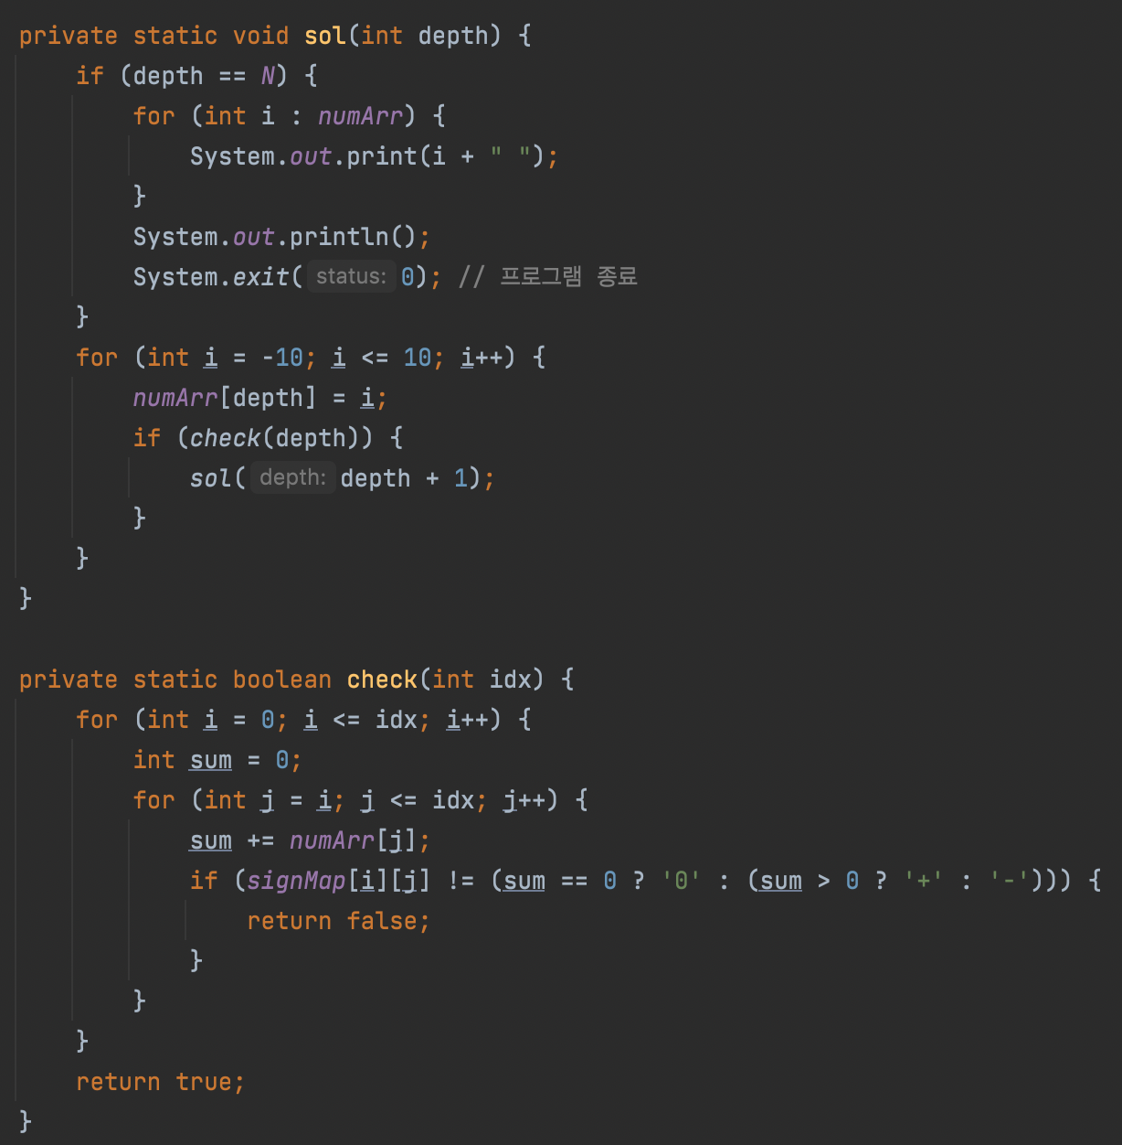
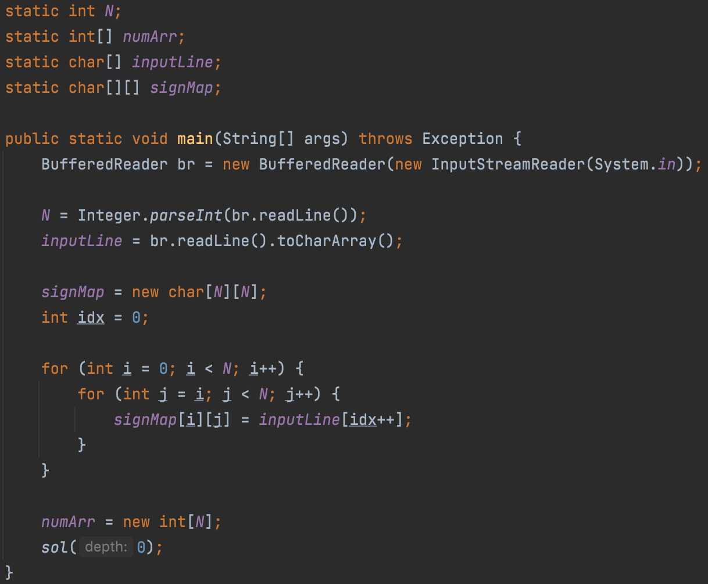

1 : 알고리즘

